Slide 1

AI in Government and Public Sector
Michael Garcia, Hashim Sayed Hoosini
July 7, 2025

Slide 2

Introduction: What Is AI in Government?
Artificial Intelligence in the public sector refers to the use of advanced computing systems to help governments perform tasks that typically require human intelligence. These tasks include understanding language, analyzing complex information, and recognizing patterns. Governments use AI to improve services, respond more quickly to citizen needs, and support decision-making across areas like public safety, infrastructure, and healthcare.

Slide 3
Domain, Overview & importance
The government handles public services, security, and policymaking.
The public sector includes health, education, transportation, and justice.
Large-scale operations generate vast amounts of data.
Efficiency, transparency, and responsiveness are essential.
AI improves decision-making, service delivery, and risk management.
Citizens expect smarter, faster digital government services.

Slide 4

AI Use Case Motivation
Manual processes delay public service delivery.
Fraud, waste, and inefficiencies cost billions.
AI helps automate and streamline government operations.
Predictive tools can prevent crime or detect welfare fraud.
Example: Estonia uses AI to assist in tax filings and citizen services.
The U.S. Department of Health uses AI for Medicare fraud detection.

Slide 5
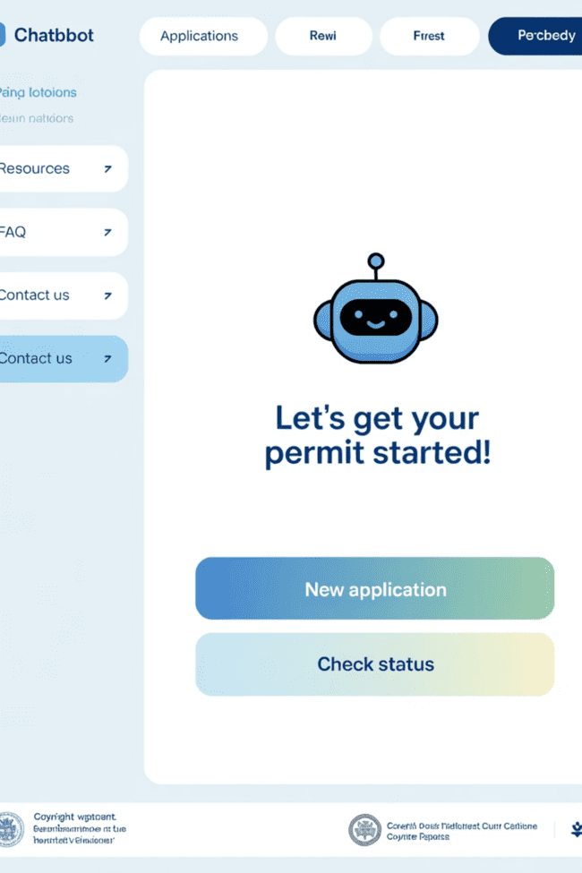
AI Techniques Used
Natural Language Processing (NLP) in Government
Natural Language Processing, or NLP, allows computers to understand and respond to human language. In government, NLP is used in virtual assistants and chatbots that talk to citizens online, helping them complete applications online, renew licenses, or get answers to frequently asked questions.
NLP is also used to scan large volumes of documents, such as legal files or complaints, and categorize them for faster human review. This helps reduce delays and improves how public service teams manage time.

Slide 6
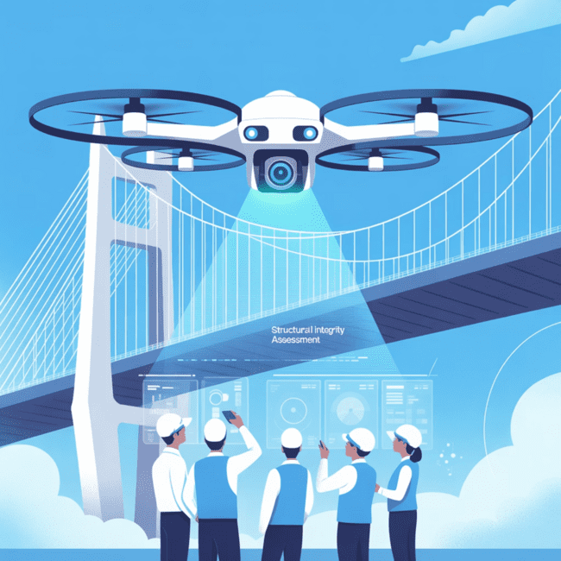
AI Techniques Used
Computer Vision and
Infrastructure Monitoring
Computer vision allows AI to interpret images and video. Governments use this to automatically monitor roads, bridges, and buildings by analyzing images taken by drones or traffic cameras. For example, AI can identify cracks or other damage in structures before they become dangerous.
This allows maintenance teams to focus their efforts on areas that need urgent attention. It also supports environmental monitoring by helping detect illegal dumping or forest fires through satellite imagery.

Slide 7
AI Techniques Used
Predictive Analytics for Better Policy Decisions
Public Health Response
Traffic Management
Planning Ahead
If a public health agency sees an increase in flu cases in certain neighborhoods, predictive models can suggest where to send medical teams next.
These tools are also used in traffic management, where they analyze road usage data and suggest how to optimize signal timings or plan repairs.
Predictive analytics turns past events into useful forecasts that help governments plan ahead.

Slide 8





Key Applications
U.S. IRS
RPA to process tax forms faster and reduce backlog.
Singapore
AI chatbot "Ask Jamie" answers public service questions.
UK Home Office
AI scans visa applications for fraud patterns.
New York City
AI-powered 311 system handles citizen complaints.
Law enforcement: predictive policing in Los Angeles and Chicago.
AI improves emergency response through real-time data.

Slide 9

Impact & Benefits
Faster, more efficient service delivery.
Cost savings through automation.
Reduced human error in data-heavy tasks.
24/7 access to information via AI chatbots.
Smarter decision support for policies and planning.
More transparency and trust in digital governance.

Slide 10
Challenges & Risks
Privacy Concerns
Algorithmic Bias
Risk of surveillance overreach and privacy violations.
Bias in predictive policing or benefits distribution.
Data Fragmentation
Adoption Barriers
Data silos limit AI effectiveness across departments.
Resistance to change and lack of AI skills.
Vendor Dependence
Ethical Dilemmas
Dependence on private tech firms raises concerns.
Ethical use of AI in law enforcement is debated.

Slide 11
Future Directions
1
Digital Identity
AI-powered citizen digital identity platforms.
2
Ethical Frameworks
AI ethics and accountability frameworks in government.
3
Data Collaboration
Federated data models for cross-agency collaboration.
4
Real-time Monitoring
Real-time AI dashboards for public health and safety.
5
Legal Automation
Automated legislative and legal drafting tools.
6
Civic Engagement
Participatory governance tools using AI analysis.

Slide 12
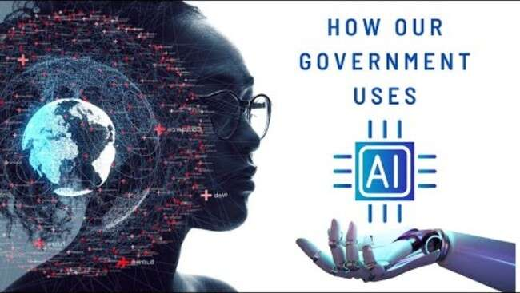
Interactive Slide / Demo
Simulation: AI flags suspicious tax filings.
Chat demo: government service chatbot interaction.
Short quiz: which departments can benefit most from AI?
Infographic: AI in a digital government ecosystem.

Slide 13
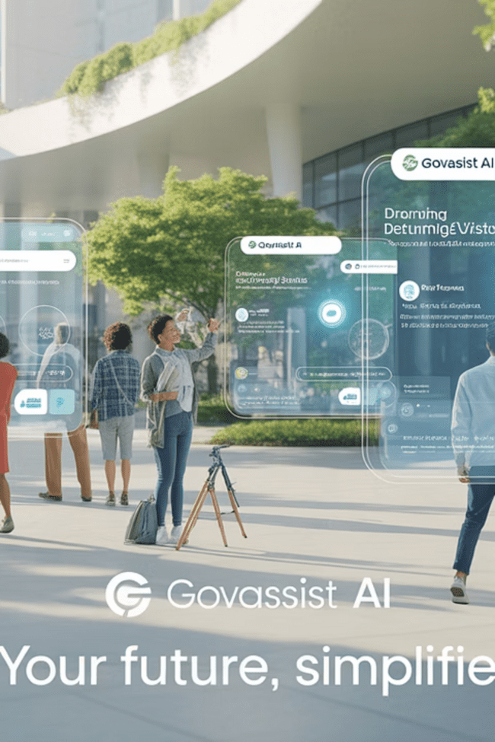
Conclusion
AI modernizes the public sector with speed and intelligence.
Enhances services, security, and civic engagement.
Reduces waste and improves government accountability.
With transparency and fairness, AI empowers citizens.
The future of governance is data-driven and automated.

Slide 14
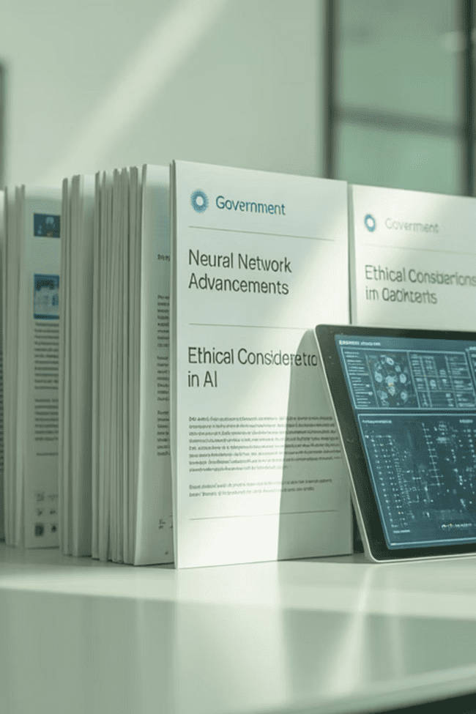
References & Acknowledgments
U.S. General Services Administration. (2023). AI in Federal Government. https://digital.gov/topics/artificial-intelligence
Estonia AI Governance. (2022). https://e-estonia.com
Singapore GovTech. (2021). https://www.tech.gov.sg/products-and-services/ask-jamie
UK Home Office AI Use. (2022). https://www.gov.uk
NYC 311 AI System. (2020). https://www.nyc.gov
U.S. Department of Health AI. (2023). https://oig.hhs.gov

